Slide 1


DIGITAL FRONT DESK
SYSTEM
Modernizing Patient Management for Private Hospitals in India
Software Engineering (CO311)
CSB23010 | CSB23012
Autumn
25th November
2025
CSB23016 | CSB23017

Slide 2

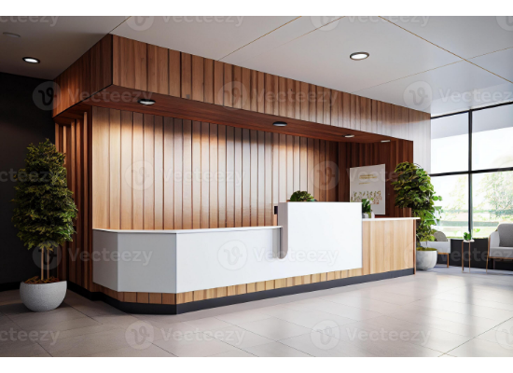
Introduction
A digital solution that replaces slow, manual front-desk workflows.
Handles registration, appointments, token system, billing, and insurance.
Designed for private hospitals in India following NDHM/ABDM standards.
Integrates with HIS, LIS, Pharmacy, and Payment Gateway.

Slide 3
Problem Statement
Fragmented Workflows: Disconnect between reception, doctors, and billing.
High Error Rate: Manual data entry leads to clerical errors and duplicate records.
Long Wait Times: Inefficient queuing reduces patient satisfaction.
Compliance Issues: Difficult to maintain NDHM/ABDM compliance with paper records.
Lack of Automation: No automated insurance checks or digital consent processes.

Slide 4
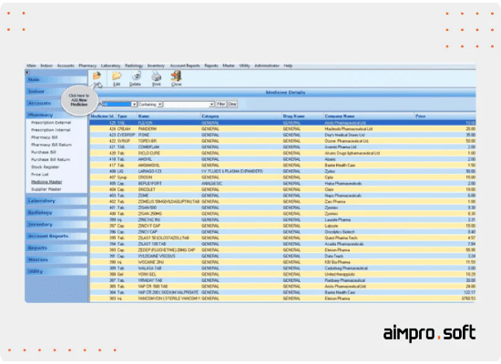
Our Solution: Digital Front Desk
Centralized, web-based front-desk module.
Real-time queue and token management.
Automated appointment creation & check-ins.
Integrated ABHA/Insurance verification.
SMS/WhatsApp notifications for tokens & updates.
Syncs with HIS, LIS, Pharmacy, Billing modules.

Slide 5

SRS Overview
Purpose & Scope
Actors & Environment
Purpose: Define functional & non-functional requirements for the system.
Actors: Receptionist, Supervisor, HIS Admin, Finance Team.
Scope: Covers Registration, OPD/IPD Appointments, Queue Management, Billing, Insurance, and Patient Notifications.
Environment: Web-based UI with backend API services; Integrates with existing HIS/LIS.
Constraints: Must strictly follow NDHM/ABDM & NABH guidelines.

Slide 6








Functional Modules
Appointment & OPD Management
Patient Registration
Queue & Token
Billing Initiation
Insurance Verify
Basic EMR Access
Lab & Pharmacy
Reporting
Communication

Slide 7
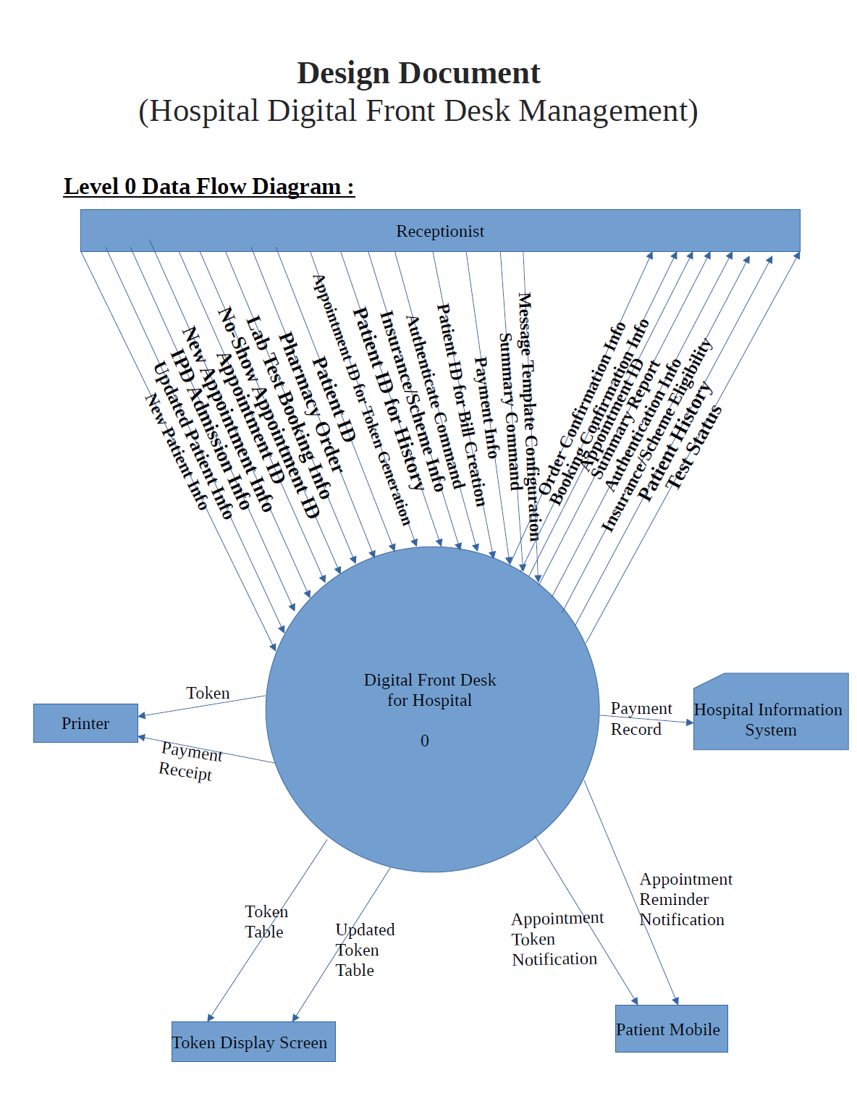
Level 0 Data Flow Diagram
System Overview
The Level-0 DFD illustrates the high-level workflow of the Digital Front Desk System.
•
External Entities: Patient, HIS Database.
•
Core Process: The Front Desk System acts as the central processor.
•
Data Flow: Captures Patient Info → Processes Token/Bill → Syncs with HIS.

Slide 8
Level 1 Data Flow Diagram
Process Decomposition
This diagram breaks down the main system into granular sub-processes.
•
Registration: ID Scan, Form Entry, ABHA Check.
•
Token Generation: Queue Algorithm, Display Update.
•
Billing: Service Selection, Payment Gateway, Receipt.

Slide 9
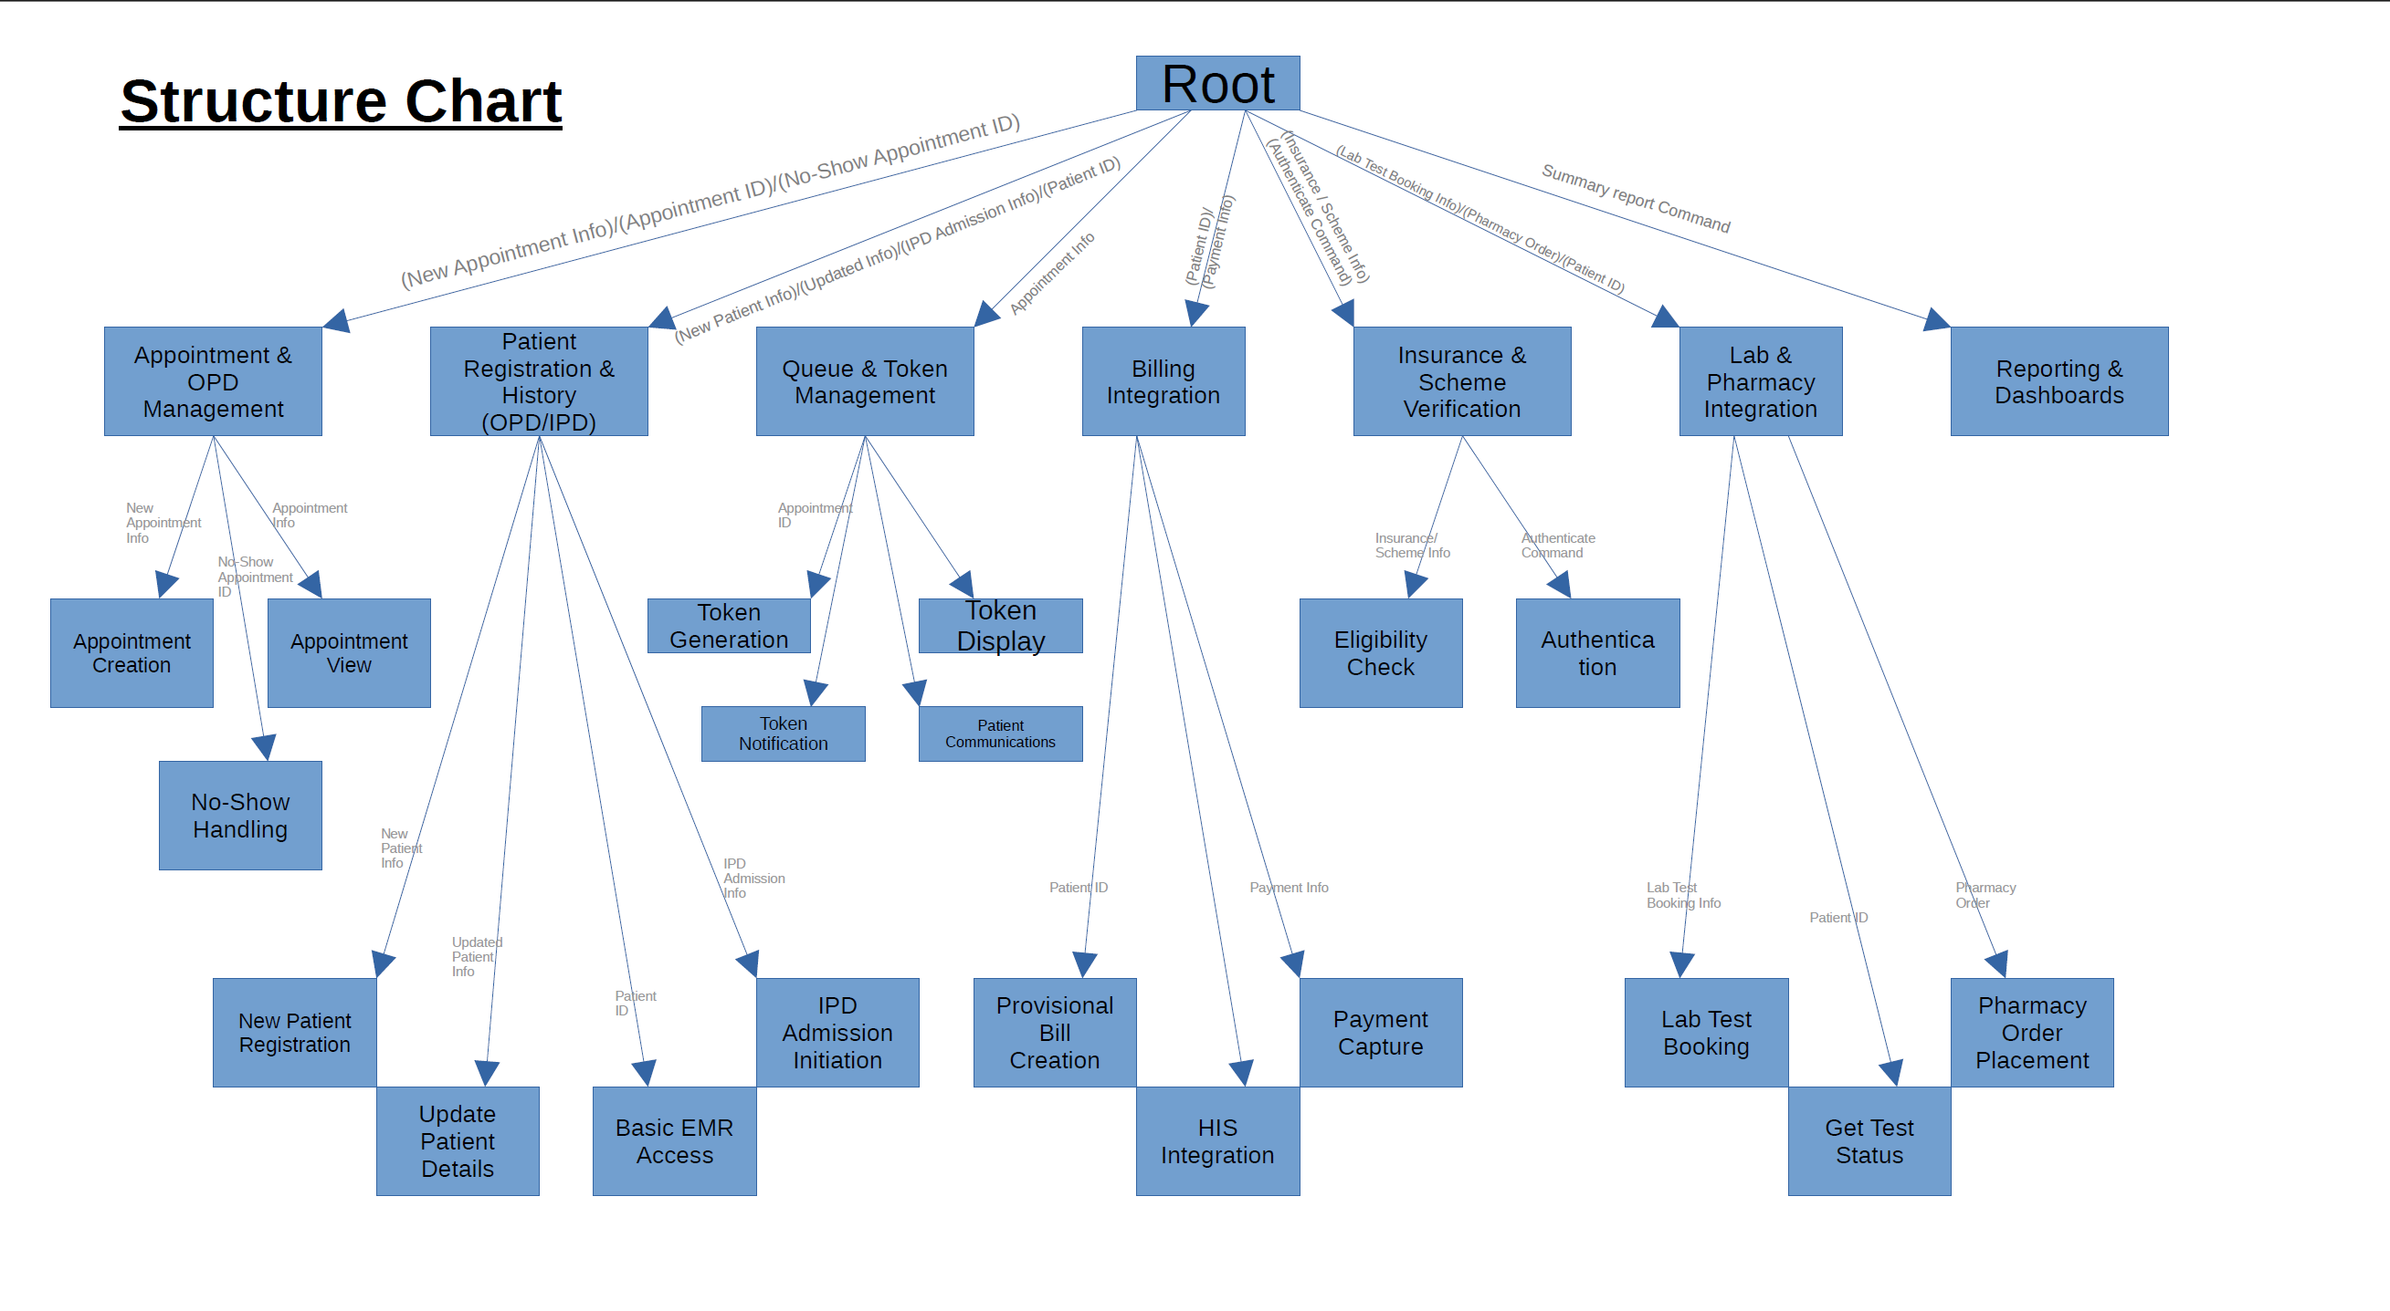
Structure Chart
System Hierarchy
A visual representation of the system's modular decomposition.
Shows the hierarchy of modules (Root: Main System) down to specific functions (leaf nodes) like 'Print Token' or 'Validate Insurance'.
Highlights the control relationship between the supervisor modules and worker modules.

Slide 10
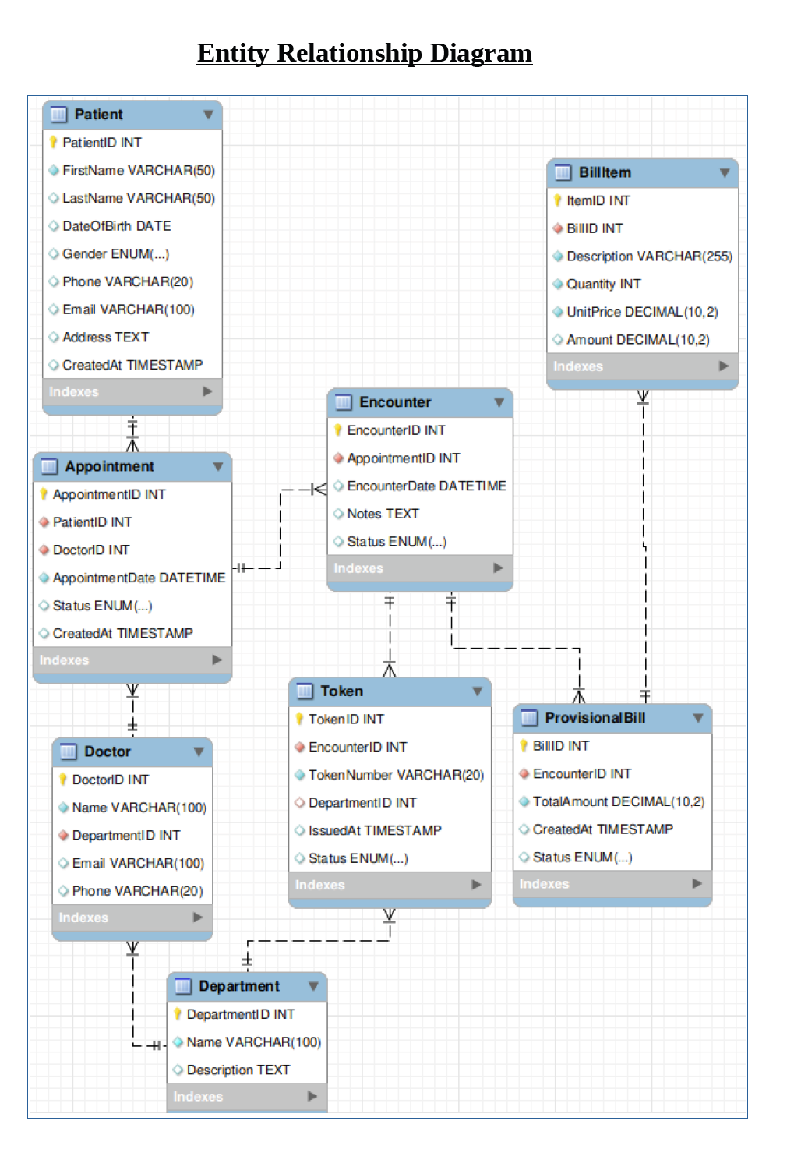
Entity Relationship Diagram
Database Schema
Defines the logical structure of the database.
•
Patient: Stores demographics, ABHA ID (PK).
•
Token: Links Patient to Queue and Department.
•
Appointment: Links Patient to Doctor/Resource.
•
Bill: Transaction details, linked to Encounter.

Slide 11





Primary Workflow (Walk-in Patient)
Scan ID
Create MRN
Token
Display
Notify
Scan Govt ID or ABHA Card
Sync Profile with HIS
Generate & Print Token
Update Queue Screen
Send SMS Confirmation

Slide 12



Non-Functional Requirements
Security
Performance
Availability
TLS 1.2+ encryption, Role-Based Access Control (RBAC), and comprehensive Audit Logs.
Token generation and display updates must occur in under 2 seconds.
99.5% system uptime guarantee to ensure 24/7 hospital operations.

Slide 13
Testing & Validation
ID | Test Scenario | Acceptance Criteria
TC-001 | Register New Patient | MRN syncs to HIS database within 5 seconds.
TC-002 | Issue Queue Token | Token number appears on lobby display board < 2 seconds.
TC-003 | ABHA Validation | System returns meaningful error message if API is down.
TC-004 | Billing Integration | Payment status updates in HIS immediately after success.

Slide 14
Limitations & Future Scope
Limitations
Future Scope
•
Heavy dependency on HIS connectivity; offline mode is limited.
•
AI Queue Prediction: Suggest best arrival times.
•
External API failures (Insurance/ABHA) may delay check-in.
•
Self-Check-in Kiosks: Hardware integration.
•
Chatbot: WhatsApp-based appointment booking.
•
Requires initial hardware setup (scanners, printers, kiosks).
•
Indoor Navigation: Guide patients to rooms via app.

Slide 15
Conclusion
The Digital Front Desk System effectively modernizes hospital reception operations.
Ensures operational efficiency, data accuracy, and improved patient flow.
Seamlessly integrates with existing HIS, LIS, and NDHM ecosystems.
Scalable design ready for future AI and IoT enhancements.

Slide 16
Thank You
Any Questions ?

